Slide 1
Introduction to Marketing
Presentation by Dr. Basavaraj Kudachimath

Slide 2
Module-1Introduction to Marketing:
Importance of marketing,
Definitions of market and marketing,
Types of Needs,
Elements of Marketing Concept,
Functions of Marketing,
evolution of marketing,
Marketing V/s Selling,
Customer Value and Satisfaction,
4P’s of Marketing,
Marketing Environment,
Techniques used in environment analysis,
Characteristics (Micro and Macro),
Marketing to the 21st century customer

Slide 3
Evolution of Marketing
Early humans had only basic requirements such as food and shelter
They themselves obtained them collecting, growing and hunting. They lived under trees or in caves. Therefore they were self- sufficient.
Once the needs became more, the man could not obtain them on his own.
Then he had to exchange for what he has with others. Eg. A farmer exchanged his rice with fisherman's fish.
It was called the Barter System
However, Barter system was not efficient. There were many problems with the barter system. E.g. Person could not easily find another person who had his need and who wanted his surplus.
Then came the introduction of medium of exchange called money.

Slide 4
The birth of selling goods and services started with the use of money as a medium of exchange.
People started producing more items than that they want and sold them in the market for money and obtained their other requirements from the money they received,
That gave birth to markets. Markets are places where customers and suppliers met. They were geographical places. It was a pre-planned place at a pre-planned time to exchange goods.

Slide 5
Markets
The excess items were sold in the market and markets became very competitive
Producers met the buyers directly at the market place.
After some time the producers could not handle selling effectively.
There were problems of sharing time for production and selling and many other practical problems.
As a results specialist sellers were born. They are called the middlemen.

Slide 6
The focus shifted to sales, retaining customers, finding new customers
Selling could not be done well without really understanding the needs and wants of customers
Therefore customers became more important
A customer oriented approach had to be used
That paved the way to form businesses as marketing organizations

Slide 7
Needs and Wants
Needs
Needs are the basic necessities which are to be satisfied by every human being. If needs are not satisfied we feel deprived. Therefore everybody tries to satisfy them

Slide 8
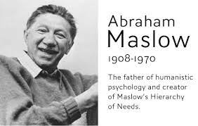
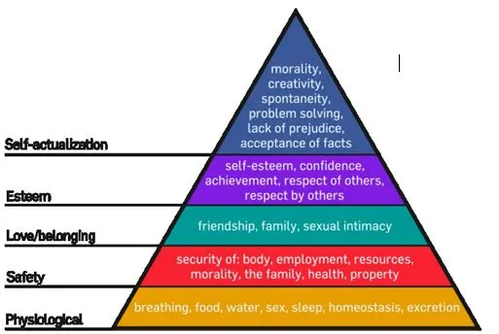
Types of Needs

Slide 9
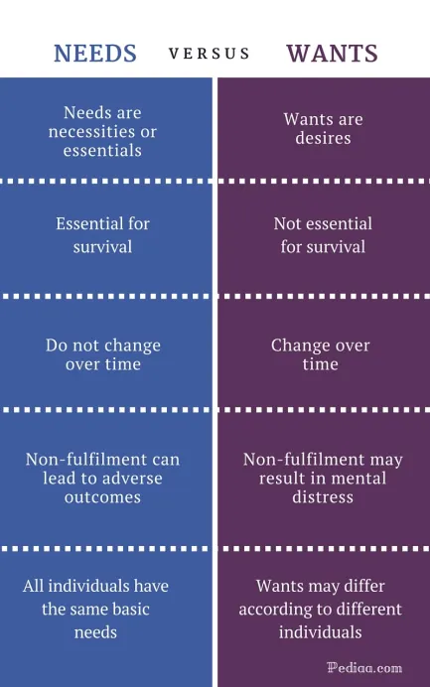
Wants: Wants are the desires which arise due to need. Wants are the ways to satisfy needs. Wants are many , which may arise one after another.

Slide 10

Demand
Demand is a desire backed up by willingness to buy and ability to pay.
“All desires are not wants but all wants are desires”

Slide 11
What is Marketing?
Marketing is a societal and managerial process where people and organisations ( customers) obtain what they need and want by exchanging products and services of value with each other
Marketing focuses on the needs and wants of customers.
It is concerned about satisfying customers through supply of goods and services
Many think marketing is only advertising and selling. But marketing is almost a way of life that everybody needs to know.

Slide 12
All profit and non profits are using marketing
Marketing is not only used by commercial profit oriented organisations but also by other organizations such as temples, churches and many other not for profit organizations and persons.
For example : Temple/Church provide their service ( product) to its congregation( customer) It announcers its activities
( promotion) to its congregation (target market). It depends on funds of congregation ( price/payment) for its survival. Further it is located where their congregation can have easy access
( place).
Therefore customer would be the most important element of any marketing organization.
Marketer needs to strive to satisfy its customers as “ No customers means No business”

Slide 13
Few definitions of Marketing
Adams Smith( 1776) “ Consumption is the sole purpose of all production and interest of product ought to be attended to, only so far as it may be necessary for promoting that of the consumer”

Slide 14
Phillip Kotler( The Millennium Edition –2000) “Marketing is a societal process by which individuals and groups obtain what they want through creating, offering and freely exchanging products and services of value with others
Chartered Institute of Marketing – UK
“ Marketing is a management process, which is responsible in identifying, anticipating and satisfying customer needs and wants at a profit”

Slide 15
American Marketing Association
“Marketing Management is the process of planning and executing the conception, pricing, promotion, and distribution of ideas, goods and services to create exchanges that satisfy individual and organisational goals”
Dibb, Simkin,Pride and Ferrel
“Marketing Consists of individual and organizational activities that facilitate and expedite satisfying exchange relationships in dynamic environment through the creation, distribution, promotion and pricing of goods, services and ideas”

Slide 16
Core ingredients of various definitions indicate the key functions and activities of marketing
Customer is the center of all Marketing activities.
Marketing focuses on the needs and wants of customers.
Identifying favorable emerging market opportunities
It is concerned about satisfying customers through supply of goods and services
Marketing involves analysis planning and control
Marketing is concerned about staying ahead with competition and making profits
Marketing has a heavy emphasis on relationships
Creating value to both the customer and organization

Slide 17
Development of Marketing
Marketing as an exchange process
exchange is the act of obtaining something by offering something in return ( money, services, goods or a combination)
For an exchange to take place following conditions must exists:
1. Two parties
2. Each party must possess something of value that the other party likes
3. The parties must be involved voluntarily
4. Parties must be able to communicate about their value proposition

Slide 18
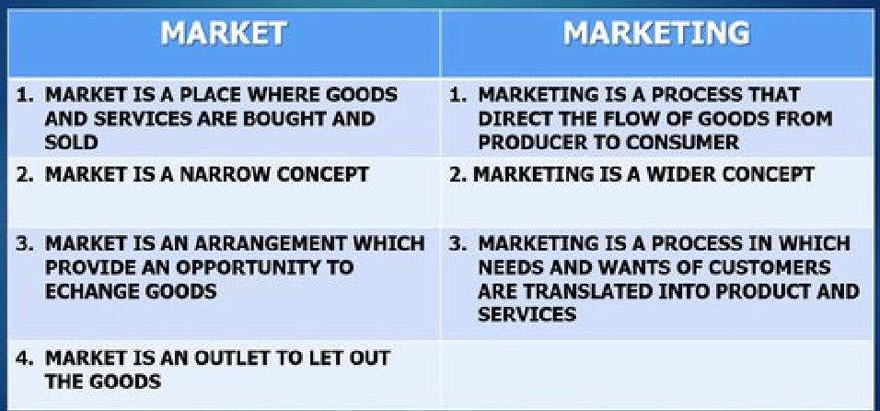
Market Vs Marketing

Slide 19
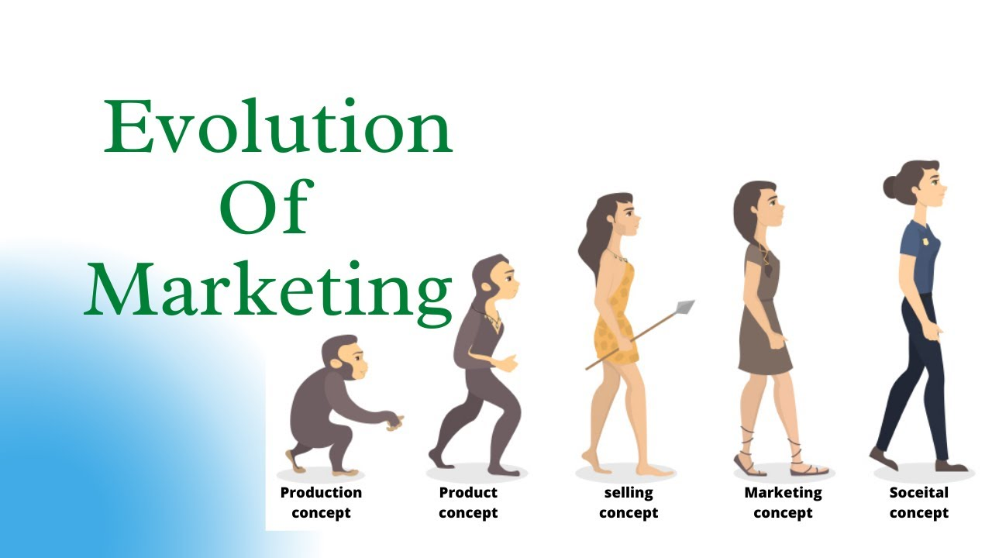
Evolution of Concepts of Marketing

Slide 20

Marketing Management Orientations in the Evolution of Marketing?
Production Concept: “ Consumers will prefer products that are widely available and inexpensive”
- Concentrates on – high production efficiency- low cost- mass distribution
Example : Ford T- Model
: Govt Hospital and other Service Depts
Heavy focus on the Price and Place on M.Mix

Slide 21
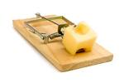
Product Concept
“ Consumers will favor those products that offer most quality, performance or innovative features”
Just making superior products will make customers seek and buy them
More focus on “Product” in the M. Mix.
Better mouse trap of Woolworth Co. Made a very effective reusable mousetrap that the existing ones but price was more than double. It did not sell well. People did not want to spend twice as they used to throw the mousetrap also with the catch.
Marketing Myopia- shortsightedness of not considering customer needs and behavior

Slide 22

Consumers have to be persuaded
Selling Concept
“If consumers are left along, will ordinarily not buy enough of the organisation’s products. Therefore the organisations must undertake aggressive selling and promotional effort”
Consumers have buying inertia and have to be persuaded
Practiced more on un soughted goods
Sell what is made or available rather than what consumer wants.
Heavy focus on Promotion on the M.Mix

Slide 23

Marketing Concept
“Key to achieving organisational goals consists in determining the needs and wants of target market and delivering the desired satisfaction more effectively than competitors”
Focus on all Ps of the Marketing mix.
To apply marketing concept three conditions should be met

Slide 24
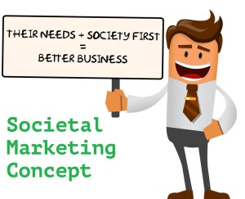
Societal Marketing Concept
The Societal Marketing Concept puts Human welfare on top before profits and satisfying the wants.
Societal Marketing emphasizes social responsibilities and suggests that to sustain long-term success, the company should develop a marketing strategy to provide value to the customers to maintain and improve both the customers’ and society’s well-being better than the competitors.

Slide 25
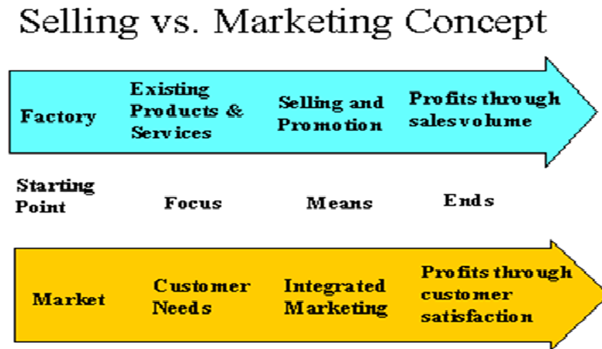
Selling Concept Vs Marketing Concept
SELLING CONCEPT
Inward focus on business.
Define business by goods and services
For everybody or the average consumer.
Profitability through sales volume
Less favorable in a competitive environment.
MARKETING CONCEPT
Outward focus on customer.
Define business by benefits for customer
To a specific group of customer
Profitability through customer satisfaction.
More favorable in a competitive environment.

Slide 26
How the companies think?
SELLING CONCEPT
MARKETING CONCEPT
Converting product into cash.
Emphasis of sale of the product already used.
Fragmented approach to selling.
Buyer beware principle followed.
Cost determine price.
Converting customers need into product.
Emphasis on product planning and development.
Integrated approach to marketing.
Seller beware principal followed.
Customer determine price , price determine cost.

Slide 27
HOW THE COMPANIES ACT
SELLING CONCEPT
MARKETING CONCEPT
Focus on seller’s needs
Manufactures the product first.
Sales volume oriented
Focus on customer needs
Identifies the customer first.
Customer satisfaction with profit oriented.

Slide 28
HOW THE COMPANIES PERFORM?
SELLING CONCEPT
MARKETING CONCEPT
Product supreme.
Profit through sales volume
Planning is short term oriented
Aims at customer satisfaction with companies profit.
Customer supreme.
Profits through customer satisfaction.
Planning is long term oriented.
Aims at customers as profit targets.

Slide 29
EXAMPLES
SELLING ORIENTED COMPANIES
MARKETING ORIENTED COMPANIES
Insurance, encyclopedia.
Online shopping.
Door-to- Door selling.
Dell computers- provides platforms on which each persons customizes the features he desires.
Automobiles industries.
Designer clothes.

Slide 30
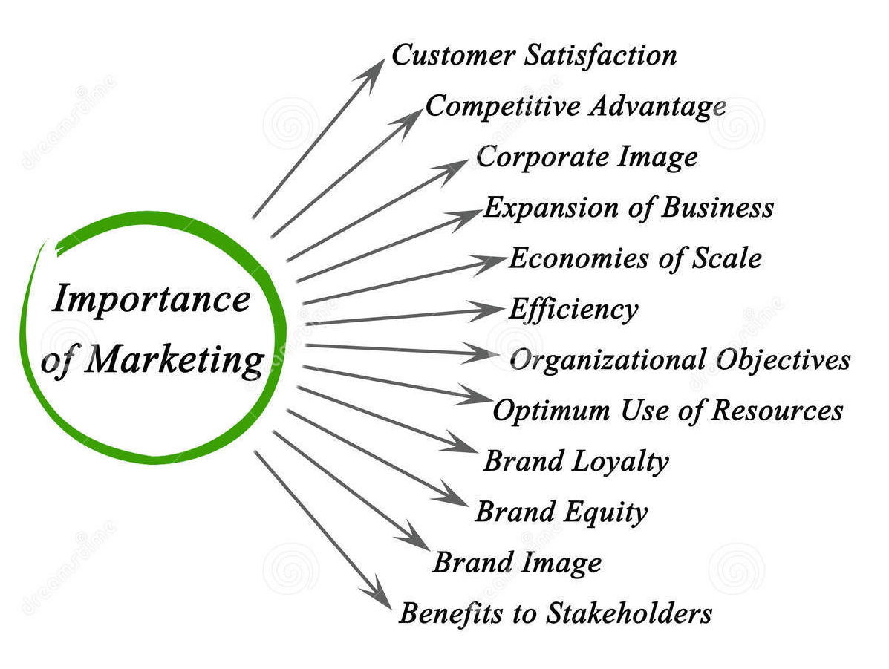
Wy marketing is required

Slide 31
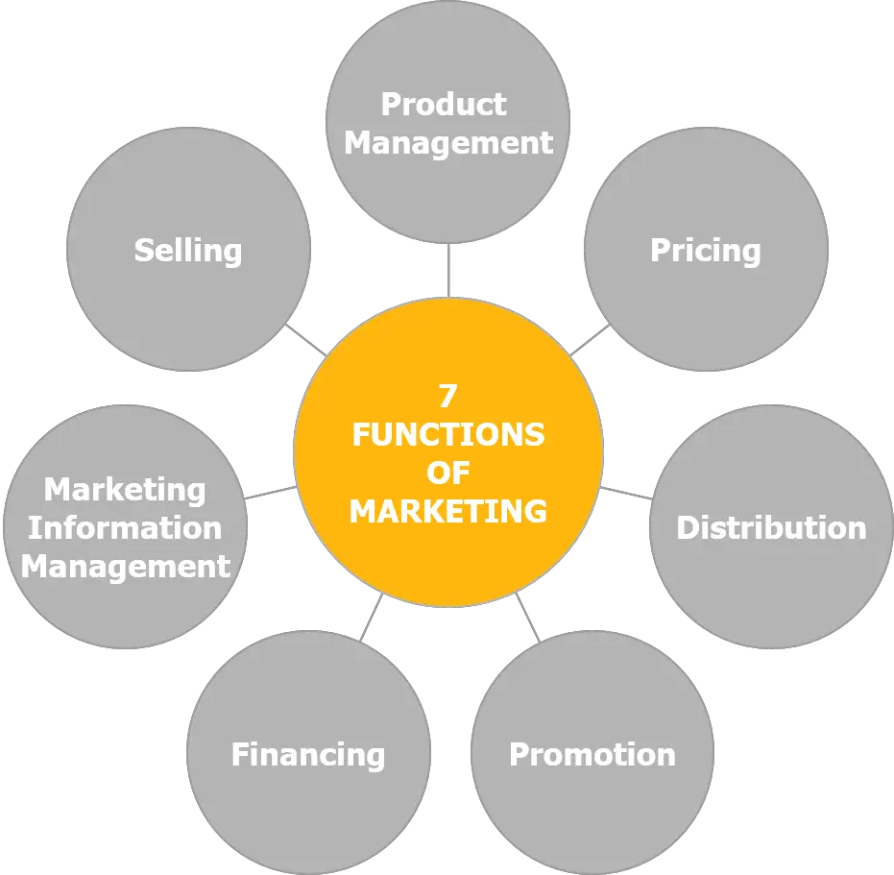
Functions of Marketing

Slide 32
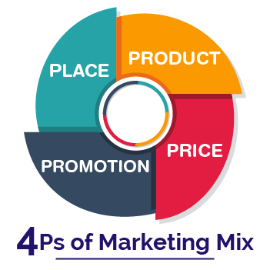
Marketing Mix
Marketing Mix is a set of marketing tool or tactics, used to promote a product or services in the market and sell it. It is about positioning a product and deciding it to sell in the right place, at the right price and right time. The product will then be sold, according to marketing and promotional strategy.
The components/ elements of the marketing mix consist of 4Ps Product, Price, Place, and Promotion. In the business sector, the marketing managers plan a marketing strategy taking into consideration all the 4Ps. However, nowadays, the marketing mix increasingly includes several other Ps for vital development.

Slide 33
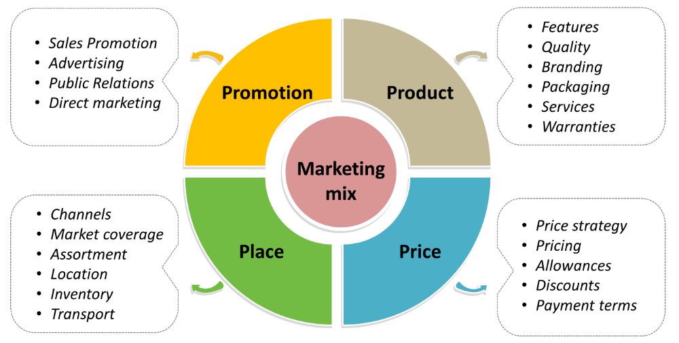
Marketing Mix 4Ps

Slide 34
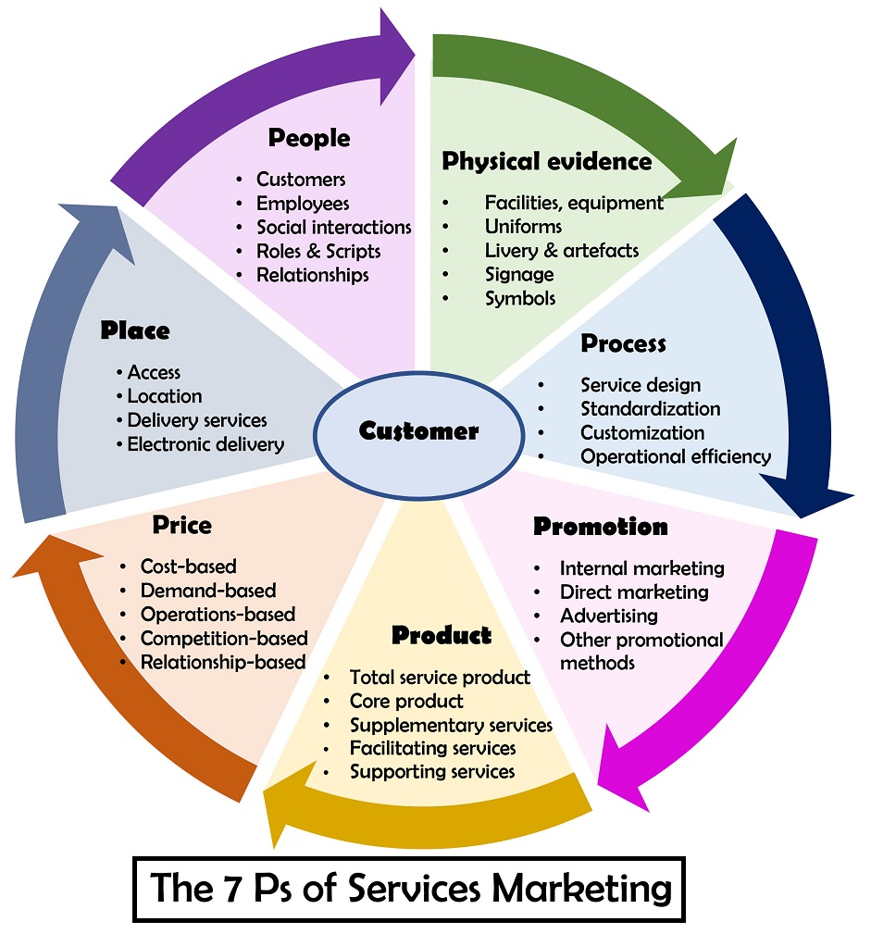
Services Marketing Mix 7Ps

Slide 35
Marketing Environment
A marketing environment encompasses all the internal and external factors that drive and influence an organization's marketing activities. Marketing managers must stay aware of the marketing environment to maintain success and tackle any threats or opportunities that may affect their work.

Slide 36
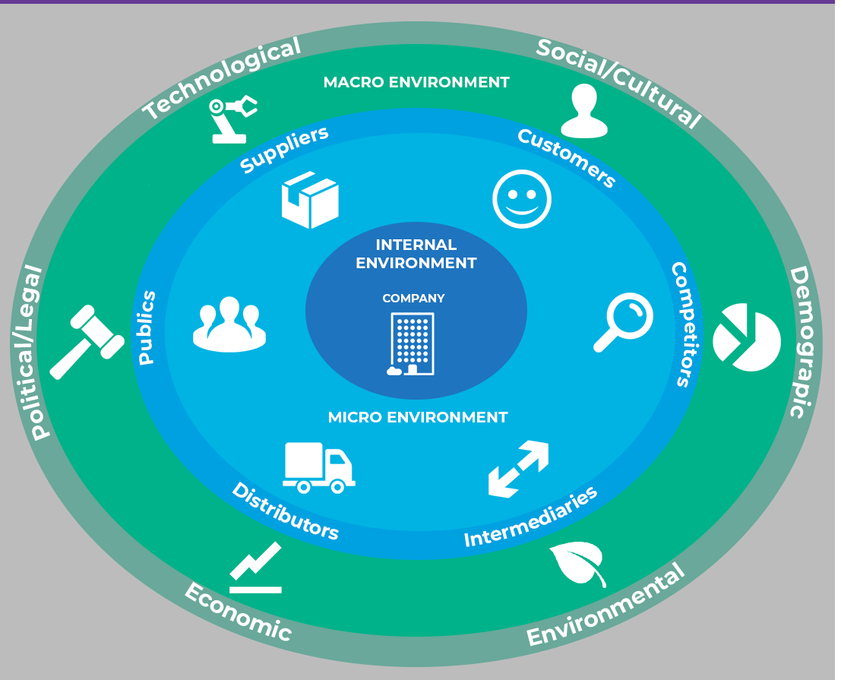
Factors of Marketing Environment

Slide 37
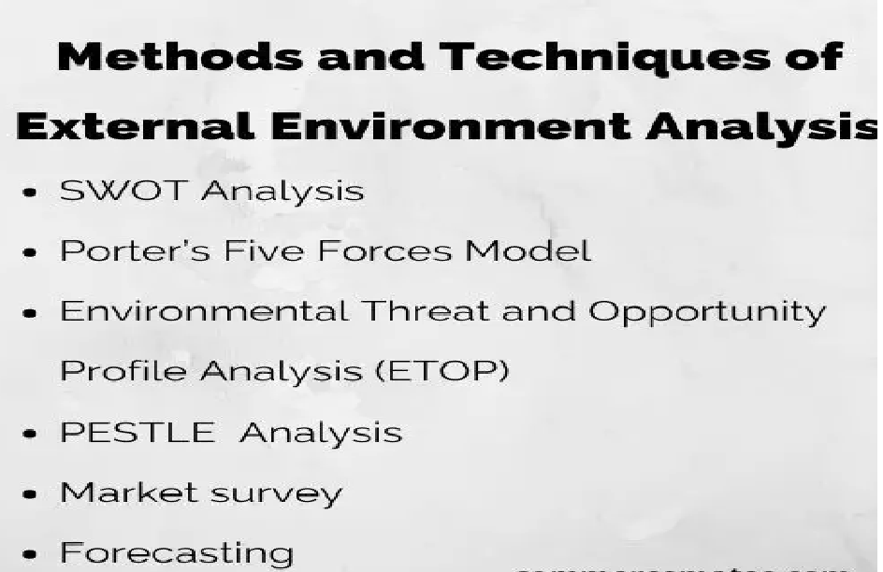

Slide 38
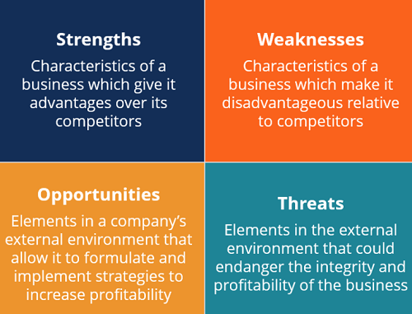
SWOT Analysis

Slide 39
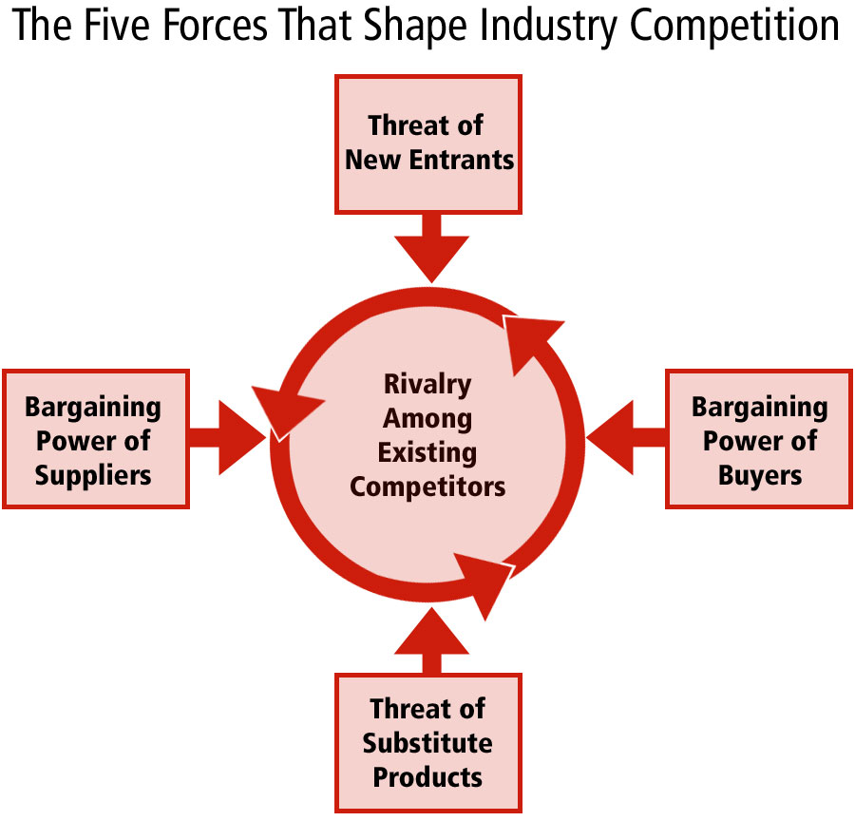
Porters 5 Forces Model

Slide 40
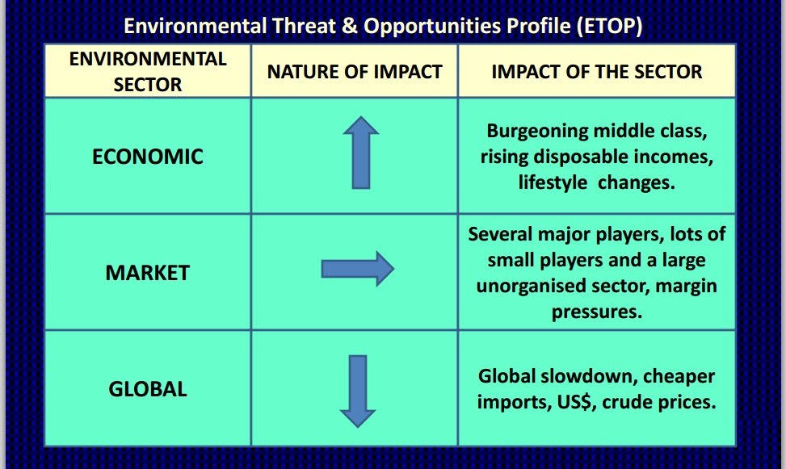
ETOP Analysis

Slide 41
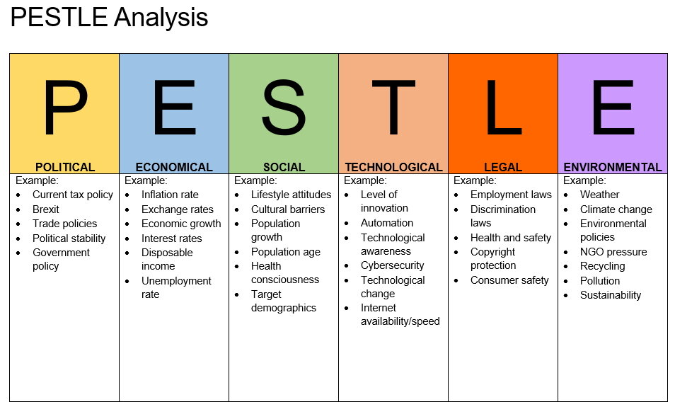

Slide 42
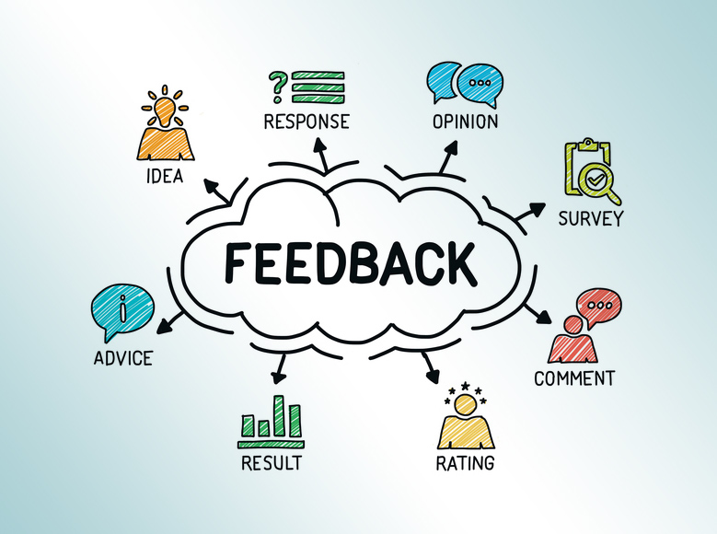
Market Survey

Slide 43
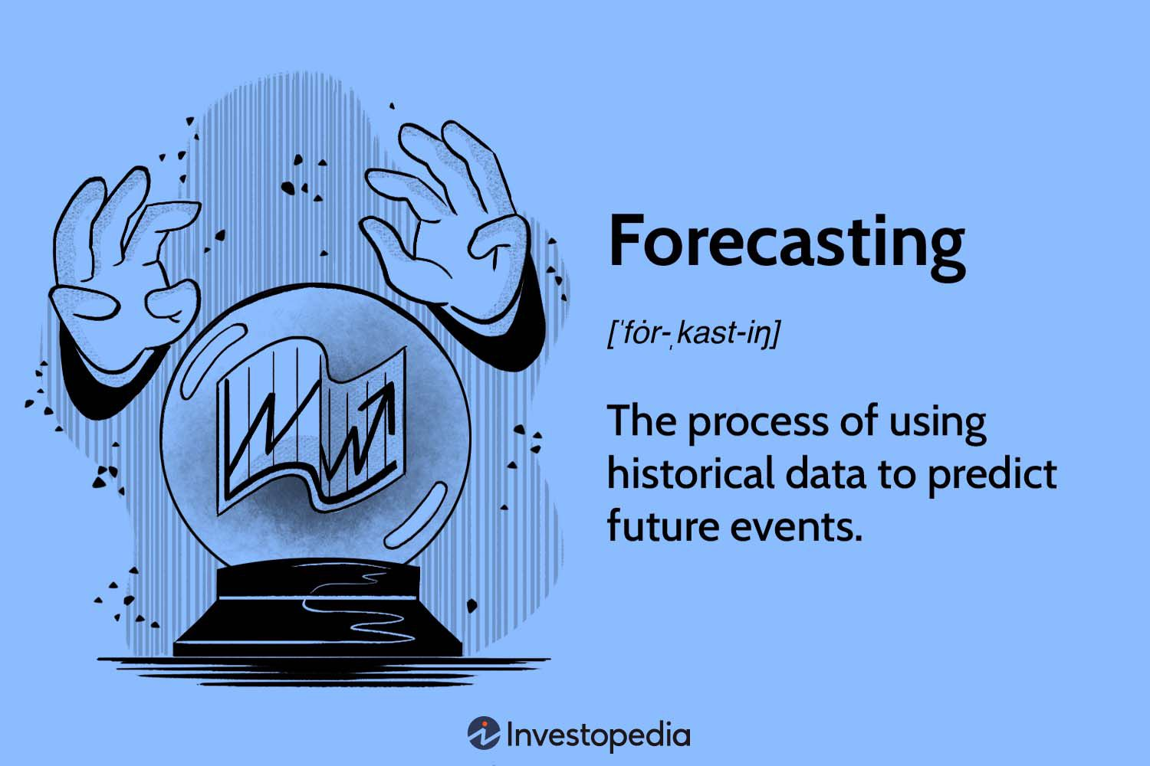

Slide 44
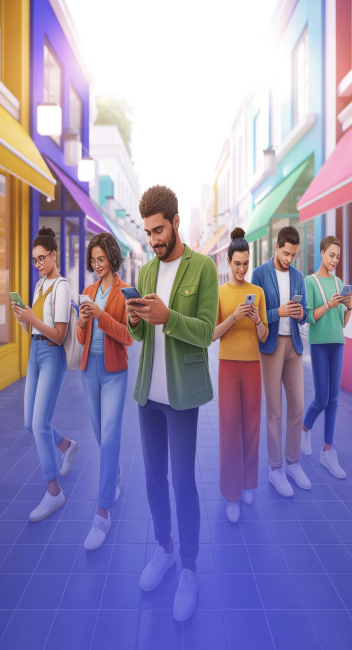
Marketing to the 21st Century Customer: Winning in a Digital, Connected World
Understanding and connecting with today's empowered, digitally-savvy consumers in an ever-evolving marketplace.

Slide 45
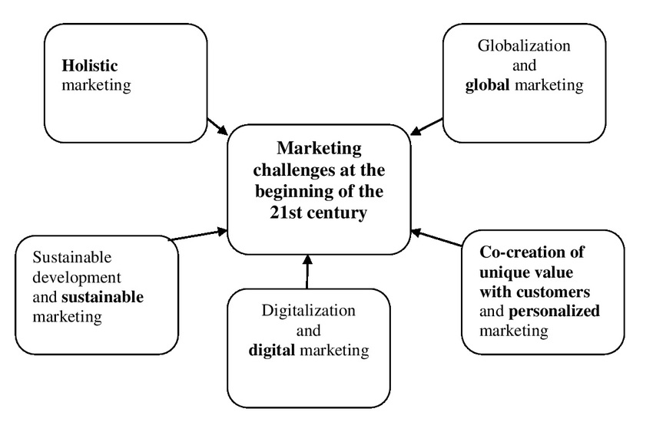

Slide 46
Characteristics of 21st century customers
The New Customer Landscape
From Mass Marketing to Personalized Engagement
Omnichannel is the New Norm
Values Matter More Than Ever
Content is King in the Attention Economy
Data-Driven Marketing: The Power of Insights
Integrating Traditional and Digital Strategies

Slide 47

The New Customer Landscape
64.4%
100%
1st
Global Population Online
Research-Driven Decisions
Trust Priority
Transparency and credibility non-negotiable
Digitally empowered and informed consumers in 2023
Customers investigate before purchasing
Today's customers actively research products through search engines, online reviews, and social media platforms before making purchase decisions. This shift has fundamentally transformed how brands must approach marketing—transparency and credibility are no longer optional extras but essential foundations for building lasting customer trust.

Slide 48
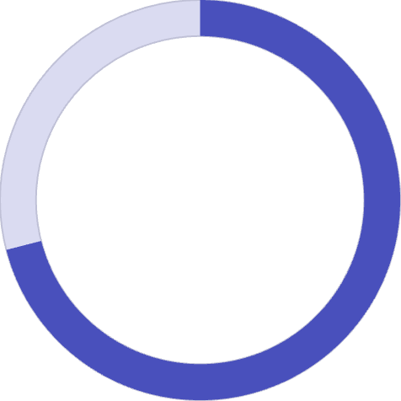
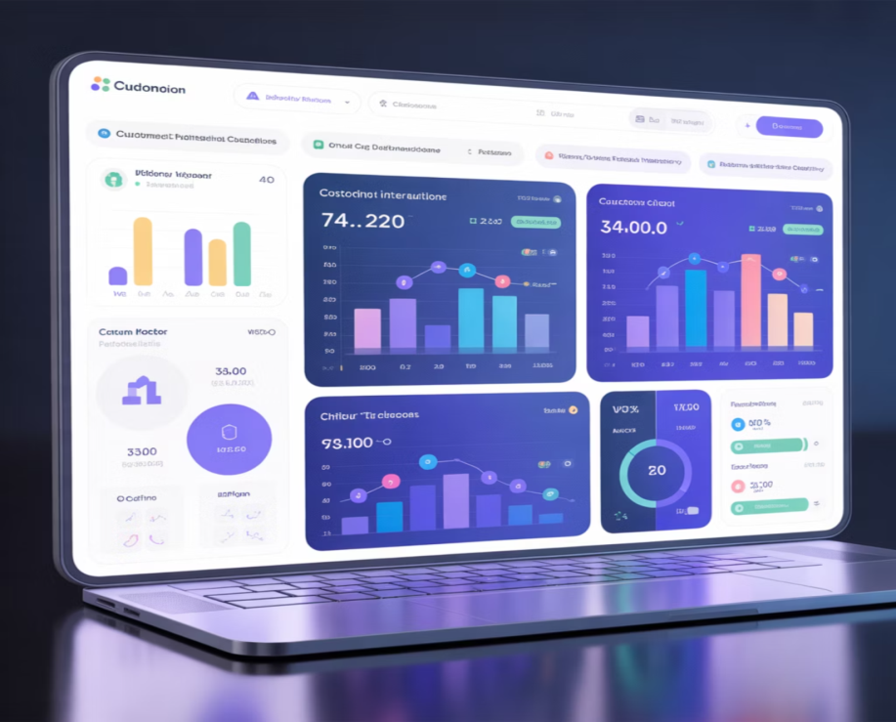
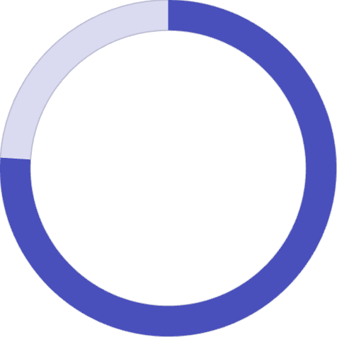
From Mass Marketing to Personalised Engagement
The Transformation
Customer Expectations
Marketing has evolved from one-way outbound broadcasts to dynamic, two-way inbound engagement through digital platforms. The era of generic mass messaging has given way to sophisticated, individualised customer experiences.
71%
Expect Personalisation
Customers demand tailored experiences
76%
Feel Frustrated
When expectations aren't met
Source: McKinsey 2022
Personalised emails, intelligent product recommendations, and dynamic website content are driving significantly higher conversion rates. Brands that embrace this shift create meaningful connections that translate directly into customer loyalty and revenue growth.

Slide 49
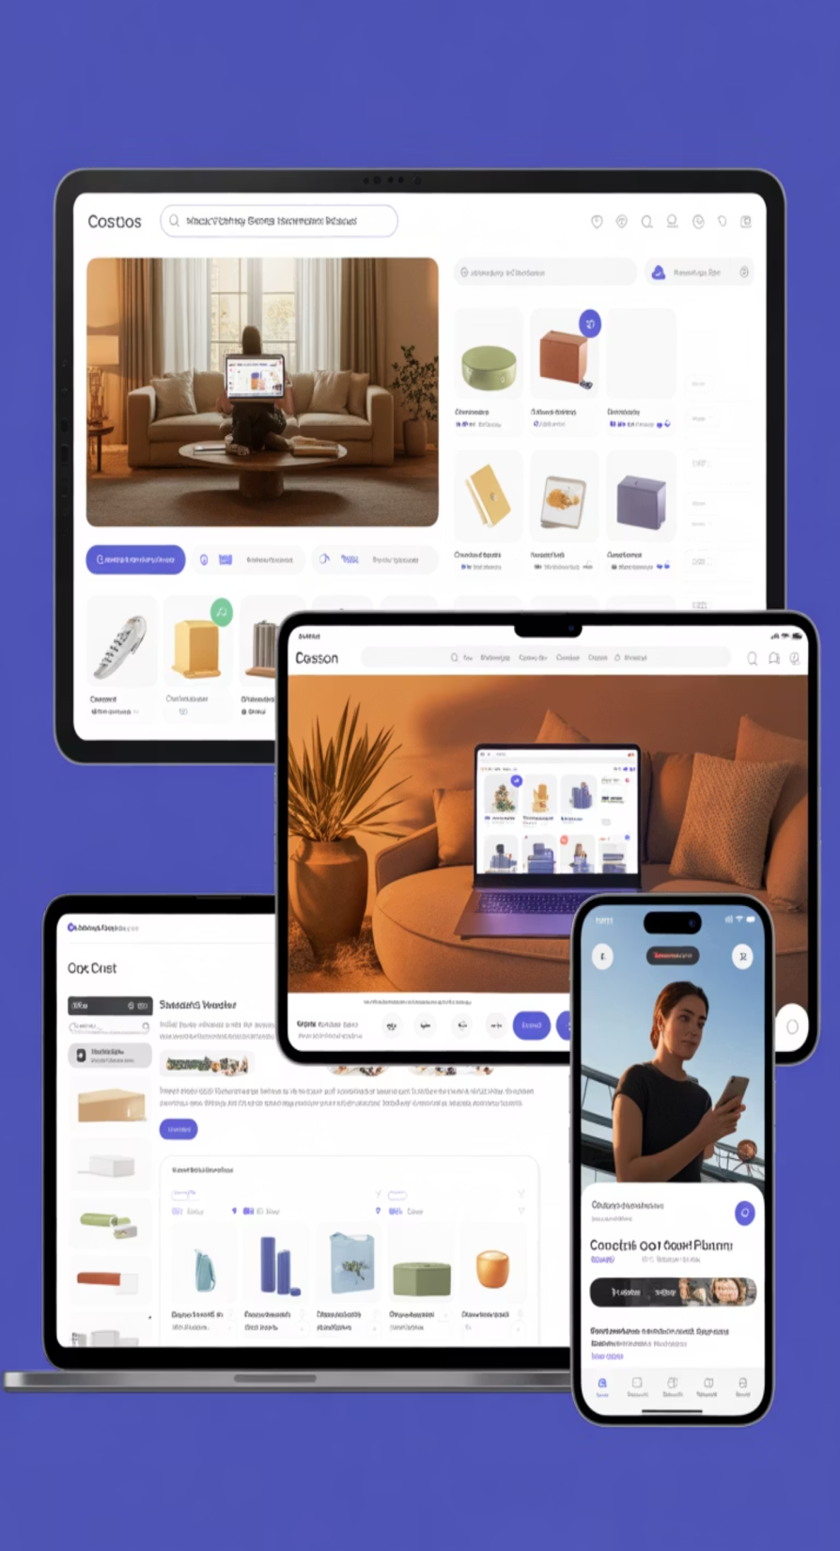

Omnichannel is the New Norm
Modern customers seamlessly navigate across websites, social media platforms, email, and mobile applications—expecting consistent, integrated experiences at every touch point.
Multi-Channel Campaigns
Customer Preference
Campaigns using 3+ channels achieve 494% higher order rates
73% prefer shopping through multiple channels, spending 10% more
Source: Omnisend
Source: Harvard Business Review 2023
Seamless Integration
Unified experiences across all platforms drive customer satisfaction and loyalty

Slide 50


Values Matter More Than Ever
83%
Millennials Choose Values-Aligned Brands
Today's consumers, especially millennials, actively seek brands that align with their personal values around sustainability, inclusivity, and social responsibility.
Beyond Price
Indian Market Focus
Competitive pricing alone no longer impresses customers. Quality, brand purpose, and authentic values drive long-term loyalty and repeat purchases.
Indian consumers increasingly support brands that demonstrate ethical practices and genuine commitment to local community development and social causes.

Slide 51
Content is King in the Attention Economy
Video Marketing Dominance
Quick-to-Digest Content
Storytelling Power
91% of businesses leverage video marketing to significantly boost engagement and drive sales conversions in 2023.
High-quality, easily consumable content cuts through the daily information overload that modern consumers face constantly.
Combining entertainment with education adds genuine value, builds distinctive brand identity, and creates emotional connections.

Slide 52
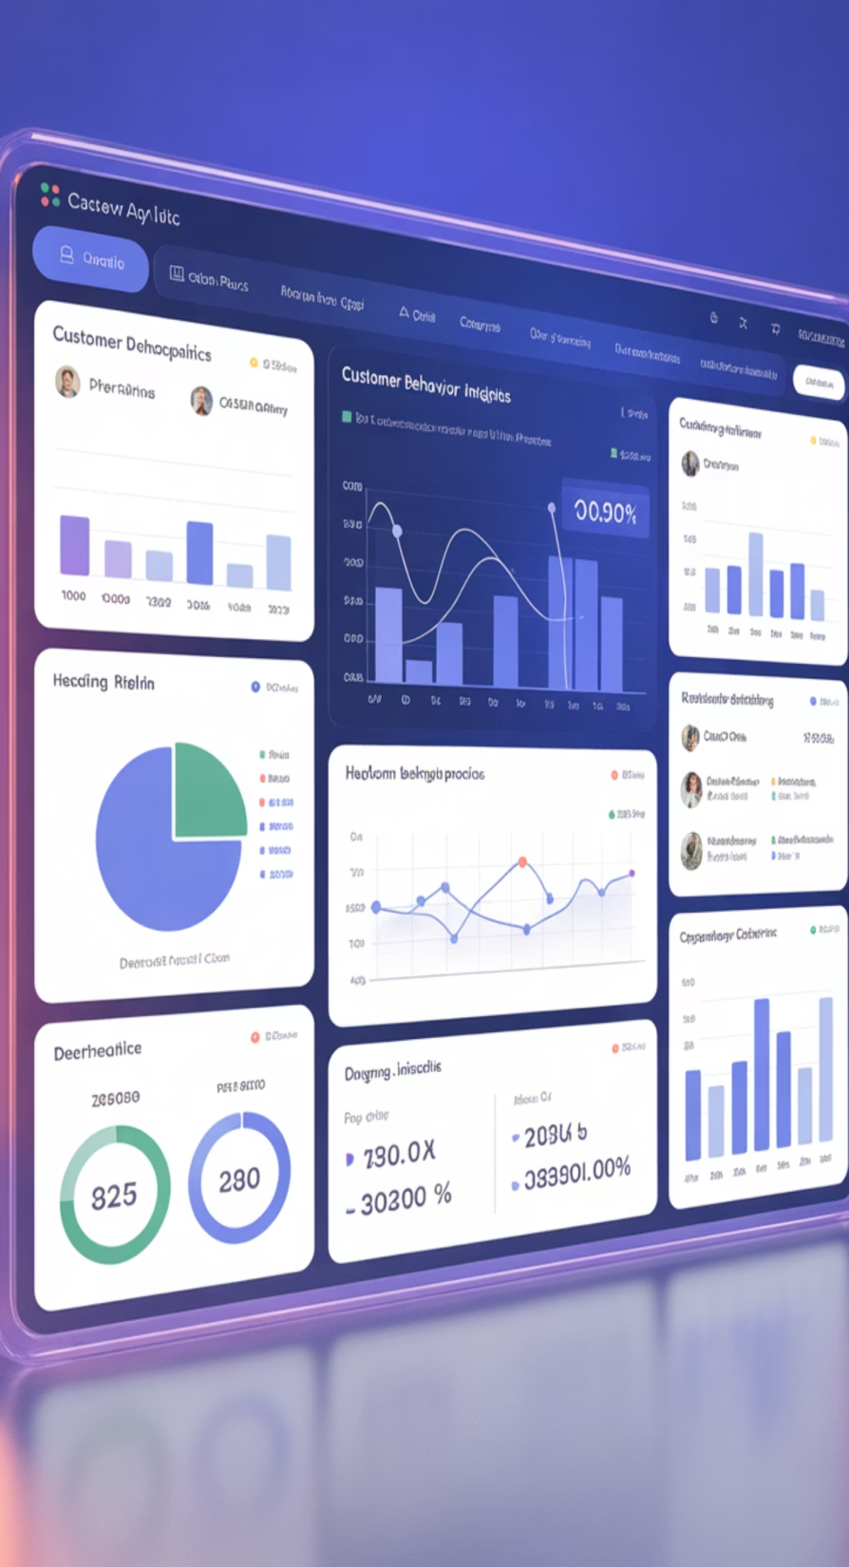




Data-Driven Marketing: The Power of Insights
Deep Customer Understanding
Analytics enable comprehensive understanding of customer personas, preferences, and behaviour patterns.
Behavioural Analysis
Tailor messaging precisely, optimise content sequencing, and stimulate viral sharing through insights.
Trust Through Ethics
Ethical data use and privacy compliance (GDPR, CCPA) are critical to maintain customer trust.
Key Insight: The most successful marketers balance data-driven decision-making with respect for customer privacy, creating personalised experiences whilst maintaining transparent, ethical practices.

Slide 53
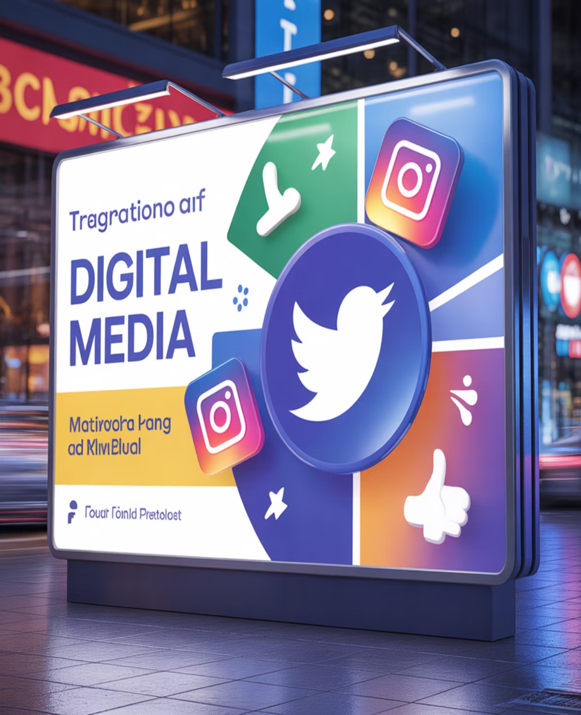
Integrating Traditional and Digital Strategies
Multi-Channel Approach
01
Leading Indian brands successfully blend traditional media—television, print, and radio—with digital platforms to create cohesive, comprehensive brand presence across diverse audience segments.
Television & Print
Broad reach for brand awareness and credibility building
02
Radio Effectiveness
Wide reach remains valuable, particularly in regional markets
03
Digital Growth
Global digital ad spend continues accelerating year-over-year
04
Small Business Leverage
Cost-effective digital tools enable competition and growth

Slide 54
Thank you

